Slide 1
Dashboard showing all the reasons and factors that are causing losses to the Coffee Chain Business.
By Jenish Bhanawat

Slide 2
Introduction
Coffee Chain Business Analysis
The Business have been experiencing certain losses.
A dashboard have been created to show how different variables are affecting the Coffee Chain Business.
Let's deep dive into the data and find out the possible reasons

Slide 3
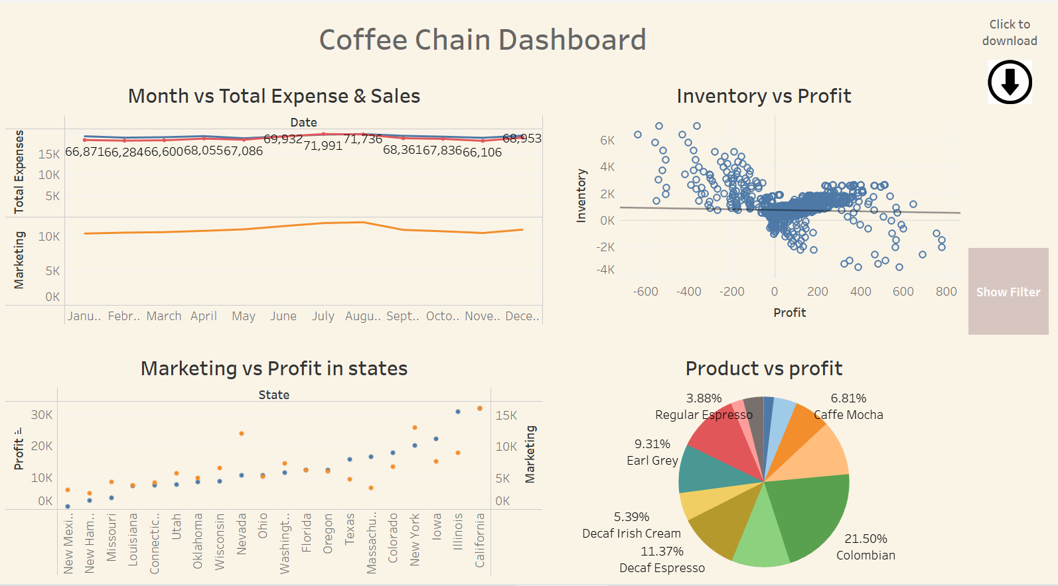
Dashboard Overview

Slide 4
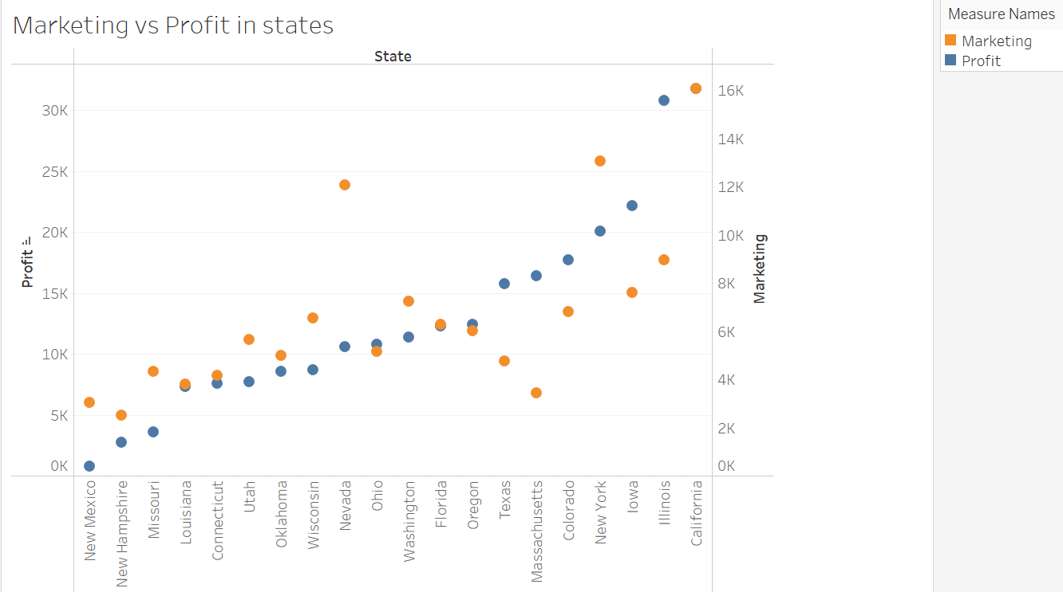
Marketing vs Profit in States
Marketing and Profit are directly proportional to each other in states. Staes experiencing less profit also having minimum marketing spends.

Slide 5
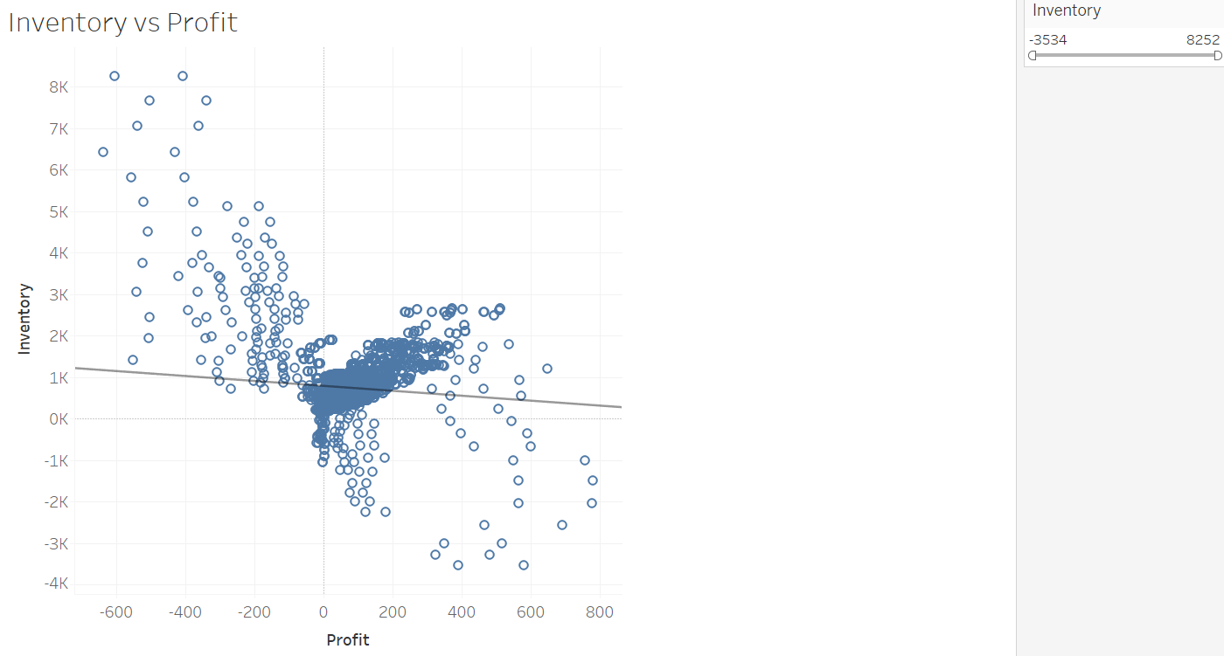
Inventory vs Profit
Inventory vs Profit is showing a downward trend. More Inventory leading to loss.

Slide 6
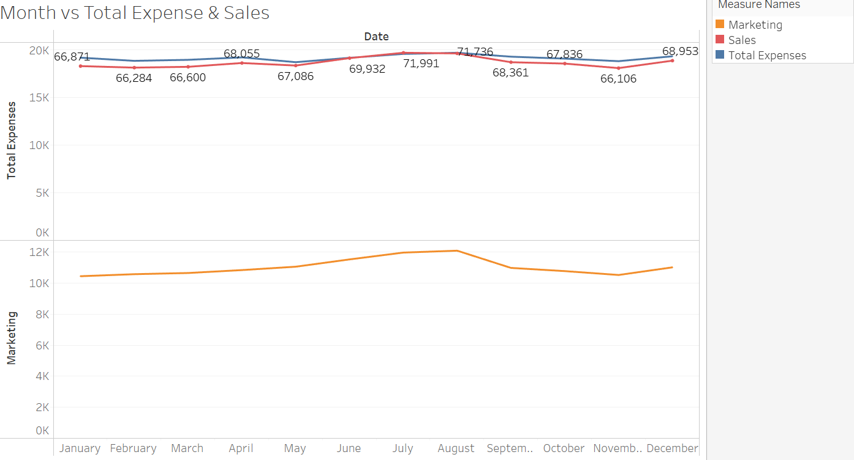
Month vs Total Expense & Sales
July and August are the months that are having sales more than total expenses. Surprisingly these are the only months that are having more marketing spends compared to other months.

Slide 7
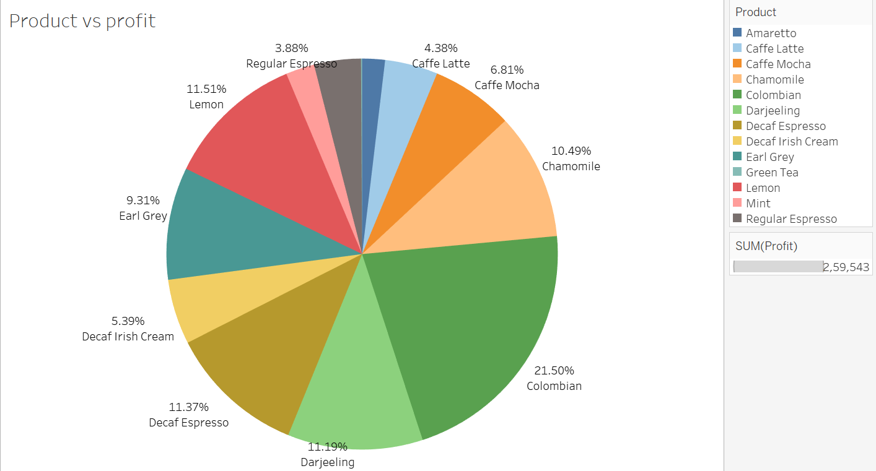
Product vs Profit
Products like Amaretto(1.88%), Grenn Tea(-0.09%), Regular Expresso(3.88%) are very underperforming. Grenn Tea is running in loss.

Slide 8
Conclusion
Sales vs. Expenses:
Sales consistently fall below total expenses, except for a notable exception in July.
State-wise Analysis:
States with the lowest profits also exhibit the lowest marketing expenditures, suggesting Marketing needs to be more higher in those states.
Inventory Impact:
A clear trend emerges—higher inventory levels are associated with losses, pointing to the need for inventory management strategies.
Product Performance:
Products such as Green Tea, Amaretto, and Regular Espresso are facing substantial losses, indicating areas for targeted improvement or reevaluation.
Seasonal Influence:
Months like July and August stand out with the highest sales, aligning with increased marketing spend during these periods.

Slide 9
THANK YOU

